Slide 1
NETWORKING

Slide 2
WHAT IS A NETWORK ?
Network is an interconnected collection of autonomous computers.
Autonomous means that no computer on networks can start, stop or control another.

Slide 3
NEED FOR NETWORKING
RESOURCE SHARING
Makes all programs, data and peripherals available to anyone on the network irrespective of the physical location of resources and the user.
RELIABILITY
A file can have copies on two or three machines so if one of them is unavailable due to any reason, the other copy could be used.
COST FACTOR
Results in less cost consumption because of sharing of resources.
COMMUNICATION MEDIA
It helps in communication between different people located at different places.

Slide 4
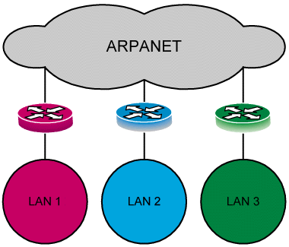
EVOLUTION OF NETWORKING
ARPANET
Advanced Research Projects Administration Network
In mid 1960s at the height of Cold War, the DOD (Department of Defense) wanted a command and control network that could survive a nuclear war.
Traditional circuit-switched telephone networks were considered too vulnerable.
To solve this problem DOD created ARPANET.
1969 ARPANET TO CONNECT COMPUTERS u.s.Defense and universities

Slide 5
TYPES OF NETWORKS
There are three basic types of networks classified on the basis of geographic area.
LAN
MAN
WAN

Slide 6
Local Area Network
Smaller networks that are confined to a localised area. ( e.g. an office, building or factory ) are known as LANs.
Metropolitan Area Network
Network spread across a city. E.g Cable T.V.

Slide 7
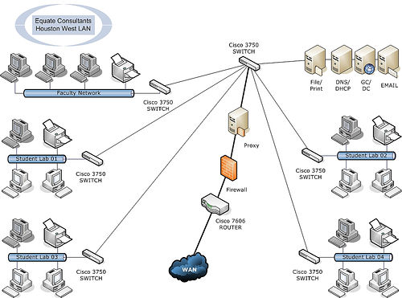
Wide Area Network
Network spread across countries. e,.g. Internet

Slide 8
Difference between LAN and WAN
LAN
Diameter is not more than a few Kms.
A total data rate of at least several Mbps.
Complete ownership by a single organisation.
Low error rates.
WAN
Spans entire countries.
Data rate less than 1 Mbps.
Owned by multiple organisations.
Higher error rate.

Slide 9
SWITCHING TECHNIQUES
There are different ways of sending data across the network.
Circuit Switching
Message Switching
Packet Switching

Slide 10
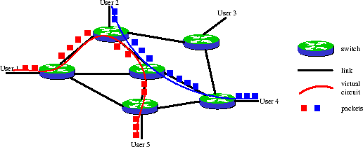
CIRCUIT SWITCHING
In this technique complete physical connection is established between 2 computers and then data are transmitted from the source computer to the destination computer. During the connection establishment, resources are allocated between the caller and the callee.

Slide 11
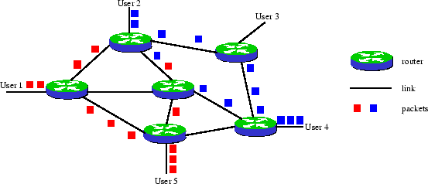
MESSAGE SWITCHING
Message switching systems are nowadays mostly implemented over PACKET SWITCHING technique.
It works on store and forward principle.
When this form of switching is used, no physical path is established in advance in between sender and receiver. Instead, when the sender has a block of data to be sent, it is stored in the first switching office (i.e. router) then forwarded later at one packet at a time.
A message is divided into small packets of fixed size. Each packet carries the address of the destination
Each packet is processed individually by a router, all packets sent by a host to another host are not guaranteed to use the same physical links. If the routing algorithm decides to change the routing tables of the network between the instants two packets are sent, then these packets will take different paths and can even arrive out of order.

Slide 12
DATA COMMUNICATION TECHONOLOGY
Concept of Channel: Channel is the media of transmission.
Baud: bits per second. It is the prevalent measure for data transmission speed.
Data Transfer rate: It is the average number of bits, characters, or blocks that can be moved from one place to another in a given time usually in a second’s time in data transmission system. (bps, Kbps, Mbps, Gbps, Tbps)
Bandwidth: In computer networks, bandwidth is often used as a synonym for data transfer rate - the amount of data that can be carried from one point to another in a given time period (usually a second). This kind of bandwidth is usually expressed in bits (of data) per second (bps).
Bandwidth is the difference between the upper and lower cutoff frequencies(cutoff frequency, corner frequency, or break frequency is a boundary in a system's frequency response at which energy flowing through the system begins to be reduced (reflected) rather than passing through. ) and is often measured in Hertz (Hz, KHz, MHz).

Slide 13
TRANSMISSION MEDIA
Transmission media enable computers to send and receive messages.
Computers can communicate through cables, light, and radio waves.
Let us learn about three basic types of cables used:
  Twisted pair Cable
  Coaxial Cable
  Optical Fibre

Slide 14
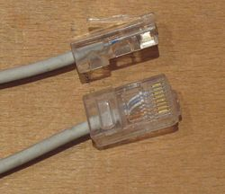
TWISTED PAIR CABLE
It consists of two identical wires wrapped together.
Advantage
Simplicity and ease of installation.
Low cost
Disadvantage
Data transmission characteristics are not so good.
The 8 pin modular jacks at both ends of an Ethernet cable, clearly showing the wire pairs inside.

Slide 15
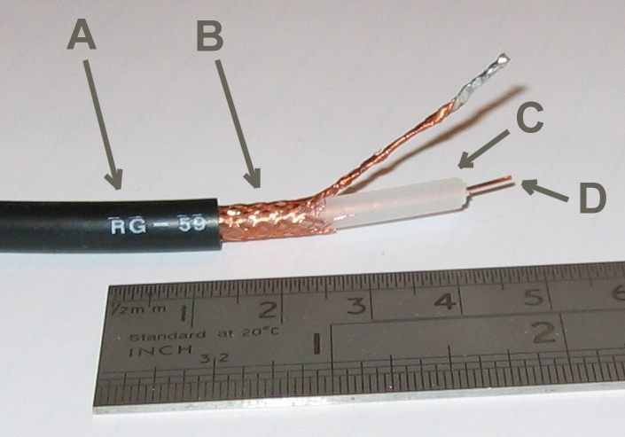
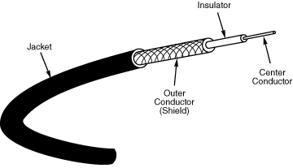
COAXIAL CABLE
The structure of coaxial cable consists of four main components as shown in the picture below.
Another ex: Cable coaxial RG-59.
A: Plastic Jacket
B: Metallic Core
C: Dialetric Insulator
D: Center Core
Data transmission characteristics are much better than twisted pair cable. And cost is more than TPC.

Slide 16

OPTICAL FIBRE
It consists of thin strands of glass or glass like material to transmit data modulated onto light waves.
They carry light from a source at one end of the fiber to a detector at the other end.
Advantage
Capable of carrying more data.
Less susceptible to interference from outside world.
Much thinner.
Data can be transmitted digitally rather than analogically.
Disadvantage
Expensive to install.
Very fragile.

Slide 17
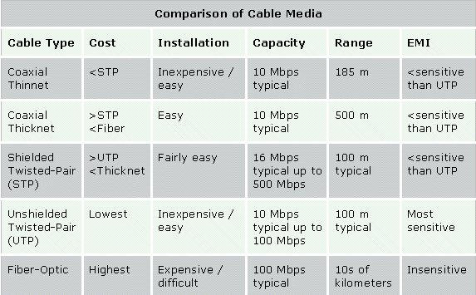
EMI is Electromagnetic Interference: It consists of outside electromagnetic noise that distorts the signal in a medium. When you listen to an AM radio, for example, you often hear EMI in the form of noise caused by nearby motors or lightning.
Attenuation: is a measure of how much a signal weakens as it travels through a medium. Attenuation is a contributing factor to why cable designs must specify limits in the lengths of cable runs.

Slide 18
WIRELESS COMMUNICATION MEDIA
RADIO FREQUENCY PROPOGATION
MICROWAVE LINK
SATELLITE
INFRARED

Slide 19
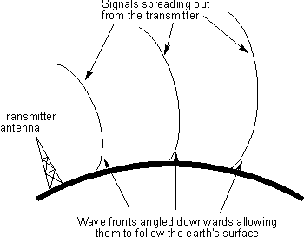
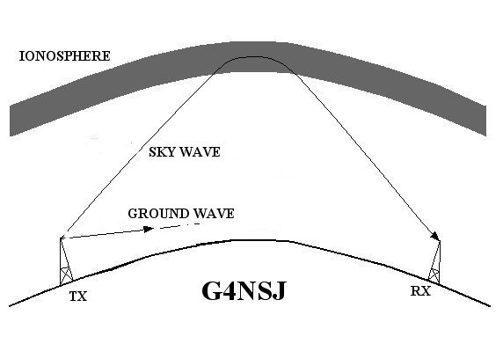
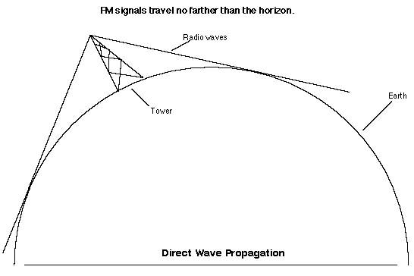
RADIO FREQUENCY PROPOGATION
Data is carried over electro-magnetic radiation in the form if radio waves.
Ground Wave
This follows the curvature of the Earth.
2. Ionospheric Propogation
This bounces off the Earth’s ionospheric layer in the upper atmosphere.
3. Line of Sight (LOS) Propogation
Transmits exactly in LOS.

Slide 20
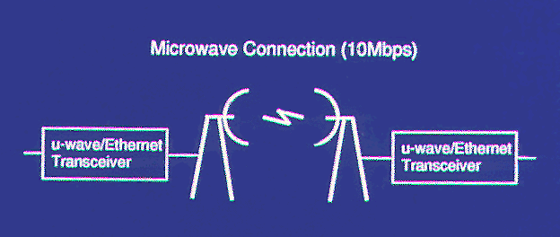
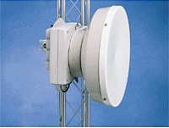
MICROWAVE LINK
For long distance communication, microwave radio transmission is widely used.
Parabolic antennas are mounted on towers to send a beam to another antenna, which could be tens of Kms. Away, but it should be in line of sight.
Microwave link use repeaters at intervals of about 25 to 30 km in between the transmitting and receiving stations.

Slide 21
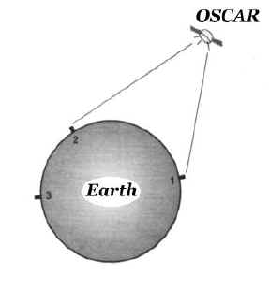
SATELLITE
The problem with microwave communication is LOS.
A communication satellite is an electrical device positioned in an orbit around the earth. It can be thought of a big microwave repeater in the sky. It contains one or more ‘Transponders’ each of which listens to some portion of the frequency spectrum, amplifies the incoming signal and then rebroadcasts it at another frequency. Different frequencies are used for ‘uplinking’ and ‘downlinking’ to avoid interference of signals.

Slide 22
INFRARED
Infrared (IR) is a form of light (or radiation) that is invisible to the human eye.
It is used for short range communication.
The remote controls used on televisions, VCRs, Stereos use infrared communication, indoor wireless LANs
Advantage
Directional, cheap, easy to build

Slide 23
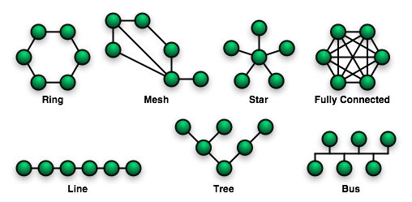
TYPES OF TOPOLOGY
In networking, the term "topology" refers to the layout of connected devices on a network.
Different types of topologies:
Star
Bus or Linear
Tree
Ring or Circular
Graph
Mesh
Fully Connected

Slide 24
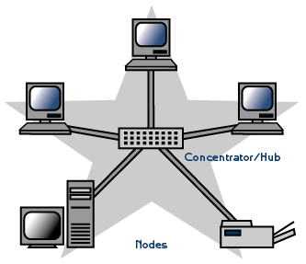
STAR TOPOLOGY
This topology consists of a central node to which all the other nodes are connected by a single path.
Advantages of a Star Topology
Easy to install and wire.
No disruptions to the network when connecting or removing devices.
Easy to detect faults and to remove parts.
Disadvantages of a Star Topology
Requires more cable length than a linear topology.
If the hub or concentrator fails, nodes attached are disabled.
More expensive than linear bus topologies because of the cost of the cables and concentrators.

Slide 25
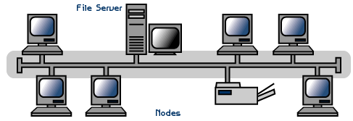
LINEAR TOPOLOGY
A linear bus topology consists of a main run of cable with a terminator at each end. All nodes (file server, workstations, and peripherals) are connected to the linear cable.
The transmission from any station travels the length of the bus, in both directions, and can be received by all the other stations.
Advantages of a Linear Bus Topology
Easy to connect a computer or peripheral to a linear bus.
Requires less cable length than a star topology.
Easy to extend.
Disadvantages of a Linear Bus Topology
Entire network shuts down if there is a break in the main cable.
Terminators are required at both ends of the backbone cable.
Difficult to identify the problem if the entire network shuts down.
Nodes need to be intelligent as there should be some way of deciding who can use the network at any given time must be performed in each node.

Slide 26
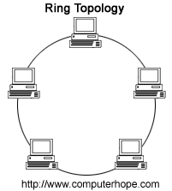
RING TOPOLOGY
The ring topology is a type of computer network configuration where each network computer and device are connected to each other forming a large circle (or similar shape).
Each packet is sent around the ring until it reaches its final destination. Thus, the data travels in one direction only from node to node around the ring.
After passing through each node, it returns to the sending node, which removes it.
Today, the ring topology is seldom used.
Advantages
Short Cable length.
Very orderly network where every device has access to the token and the opportunity to transmit
Disadvantages
Node failure causes network failure
Difficult o diagnose problem.
Moves, adds and changes of devices can affect the network.

Slide 27
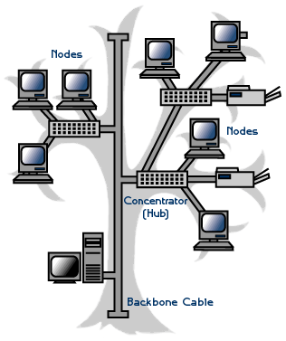
TREE TOPOLOGY
A tree topology combines characteristics of linear bus and star topologies. It consists of groups of star-configured workstations connected to a linear bus backbone cable.
Advantages of a Tree Topology
Point-to-point wiring for individual segments.
Supported by several hardware and software venders.
Disadvantages of a Tree Topology
If the backbone line breaks, the entire segment goes down.
More difficult to configure and wire than other topologies.

Slide 28
Considerations When Choosing a Topology:
Money. A linear bus network may be the least expensive way to install a network; you do not have to purchase concentrators.
Length of cable needed. The linear bus network uses shorter lengths of cable.
Future growth. With a star topology, expanding a network is easily done by adding another concentrator.
Reliability. Topology chosen for the network can help by allowing the location of the fault to be detected and to provide some means of isolating it.
Summary:
Physical Topology
Common Cable
Common Protocol
Linear Bus
Twisted Pair
Coaxial
Fiber
Ethernet
LocalTalk
Star
Twisted Pair
Fiber
Ethernet
LocalTalk
Star-Wired Ring
Twisted Pair
Token Ring
Tree
Twisted Pair
Coaxial
Fiber
Ethernet

Slide 29
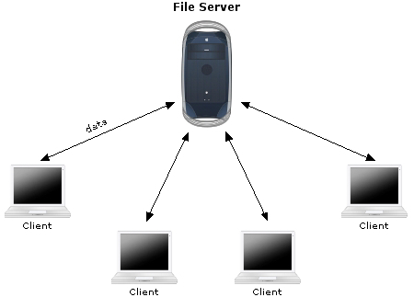

ELEMENTARY NETWORK TERMINOLOGIES
Node/ Workstation/ Client
a computer becomes a workstation of the network as soon as it is attached to a network.
Server
is a computer that facilitates the sharing of data, software and hardware resources ( e.g. Printers, Modems, etc. ) on the network.
Network Interface Unit (NIU)
is an interpreter that helps establish communication between
the server and the workstations.
NIU is a device attached to each of the workstations and the server.
NIU attached to workstation has a unique number identifying it which is known as the node address.

Slide 30
NETWORK DEVICES
MODEM
HUB
SWITCH
ETHERNET CARD
REPEATER
RJ-45 CONNECTOR
GATEWAY

Slide 31
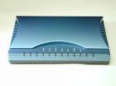
MODEM
It is a computer peripheral that allows you to connect and communicate with other computer via telephone line.
Modem changes the digital data from your computer into analog data, a format that can be carried over telephone lines.
In the sane the the modem receiving the call then changes the analog signal back into digital data that the computer can understand.

Slide 32
EHTERNET CARD
Type of LAN card developed by Xerox Corp. along with DEC and Intel.
It uses a Bus or Star topology.
Supports data transfer rates of upto 10 Mbps.

Slide 33
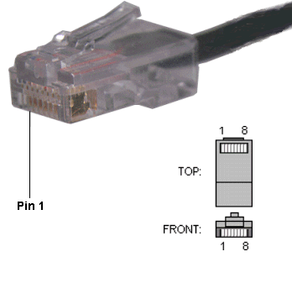
RJ-45 CONNECTOR
The Registered Jack-45 connector is commonly used for network cabling and for telephony applications.
It is an eight wire connector which is commonly used to connect computers on the local area networks, especially Ethernets.
It is similar to telephone connector RJ-11 except that it has eight wires as compared to 4 in RJ-11.

Slide 34
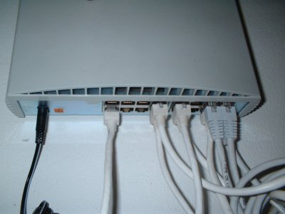
HUB
It is used to connect several computers together.
A network device the information flow is accumulated and then distributed to various groups and users.
It can be between users on the same LAN and users on different LANs.
It is often used in Star or Ring topology.

Slide 35
A network switch is a computer networking device that connects network segments.
Network switches appear nearly identical to network hubs, but a switch contains more "intelligence" (and comes with a correspondingly slightly higher price tag) than a network hub. Network switches are capable of inspecting data packets as they are received, determining the source and destination device of that packet, and forwarding it appropriately. By delivering each message only to the connected device it was intended for, a network switch conserves network bandwidth and offers generally better performance than a hub.
Switches differ from hubs in that they can have ports of different speed.
SWITCH

Slide 36

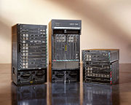
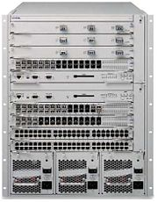
ROUTER
A router is a computer whose software and hardware are usually tailored to the tasks of routing(Routing is the process of selecting paths in a network along which to send network traffic. ) and forwarding.
This device routes the information packet between two or more physically or logically connected networks.
It is different from Bridge as this uses logical address while bridge uses physical address.

Slide 37
Routing is the process of selecting paths in a network along which to send network traffic. Routing is performed for many kinds of networks, including the telephone network, electronic data networks (such as the Internet), and transportation (transport) networks. This article is concerned primarily with routing in electronic data networks using packet switching technology.
In packet switching networks, routing directs forwarding, the transit of logically addressed packets from their source toward their ultimate destination through intermediate nodes; typically hardware devices called routers, bridges, gateways, firewalls, or switches. Ordinary computers with multiple network cards can also forward packets and perform routing, though they are not specialized hardware and may suffer from limited performance. The routing process usually directs forwarding on the basis of routing tables which maintain a record of the routes to various network destinations. Thus constructing routing tables, which are held in the routers' memory, becomes very important for efficient routing. Most routing algorithms use only one network path at a time, but multipath routing techniques enable the use of multiple alternative paths.

Slide 38
BRIDGE
It is a device that lets you link two same networks together.
Same networks mean networks with same protocol.
Bridging versus routing
Bridging and Routing are both ways of performing data control, but work through different methods. Bridging takes place at Data-Link Layer while Routing takes place at the Network Layer. This difference means that a bridge directs frames according to hardware assigned MAC addresses while a router makes its decisions according to arbitrarily assigned IP Addresses. As a result of this, bridges are not concerned with and are unable to distinguish networks while routers can.
REPEATER
It is a device that amplifies and restores a signal being transmitted on the network.
It is used in long network lines.

Slide 39
In computer networking, a Media Access Control address (MAC address) or Ethernet Hardware Address (EHA), hardware address, adapter address or physical address is a quasi-unique identifier assigned to most network adapters or network interface cards (NICs) by the manufacturer for identification. If assigned by the manufacturer, a MAC address usually encodes the manufacturer's registered identification number.
Three numbering spaces, managed by the Institute of Electrical and Electronics Engineers (IEEE), are in common use for formulating a MAC address: MAC-48, EUI-48, and EUI-64. The IEEE claims trademarks on the names "EUI-48" and "EUI-64", where "EUI" stands for Extended Unique Identifier.

Slide 40
GATEWAY
This device usually a server is used to communicate between dissimilar networks i.e. networks with different protocols.
e.g. to connect a LAN with Novell Netware with another LAN with Microsoft NT.
In enterprises, the gateway is the computer that routes the traffic from the workstation to the outside world.
In homes, the gateway is the ISP that connects the user to the Internet.

Slide 41
PROTOCOL
Protocol is a standard set of rules that govern how computer communicates with each other. Protocol determines both the format that a message must take and the way in which messages are exchanged between computers. Protocols may be implemented by hardware, software, or a combination of the two.
Some of the common protocols used on the Internet are:
TCP/IP
FTP
HTTP
PPP
TELNET

Slide 42
TCP/IP ( Transmission Control Protocol / Internet Protocol )
TCP breaks the data into packets that the network can handle efficiently, verifies that all the packets arrive at their destination and then reassembles the data. IP allots the destination address to the packets and also allots the sequence numbers.
For example, when an html file is sent to you from a Web server, the TCP program layer of that server takes the file and divides it into packets, numbers the packets, and then forwards them individually to the IP program layer. Even though every packet has the same destination IP address, they can get routed differently through the network. When the client program in your computer gets them, the TCP reassembles the individual packets and waits until all of those files have arrived before giving them to an application as one single file.

Slide 43
FTP ( File Transfer Protocol )
Protocol which enables files to be transferred from one computer to another. i.e. Downloading and Uploading of files.
FTP runs exclusively over TCP.
HTTP ( Hyper Text Transfer Protocol )
Protocol used to transfer hypertext files. Hypertext is an ordinary text that has some extra features such as formatting, images, multimedia and links to other documents.
HTTP is not constrained to using TCP/IP.

Slide 44
PPP ( Point to Point Protocol )
PPP, is a data link protocol commonly used to establish a direct connection between two nodes over serial cable, phone line, cellular telephone, specialized radio links, or fiber optic links. Most Internet service providers use PPP for customers' dial-up access to the Internet.
TELNET (Remote Login)
TELNET (TELecommunication NETwork) is a network protocol used on the Internet or local area network (LAN) connections.
Telnet is the main Internet protocol for creating a connection with a remote machine. It gives the user the opportunity to be on one computer system and do work on another, which may be across the street or thousands of miles away. In WWW publishing telnet is used to log into the web server and 'set the permissions' of files and directories. To start a Telnet session, you must log in to a server by entering a valid username and password. Telnet is a common way to remotely control Web servers.

Slide 45
WIRELESS/MOBILE COMMUNICATION TECHNOLOGIES
WLL (Wireless in local Loop) : It is system that connects subscribers to the public switched telephone network (PSTN) using radio signals as a substitute for copper for all or part of the connection between the subscriber and the switch.
GSM (Global System for Mobile Communication):
European standard
Expensive
Used by 70% of the world
In operation for about 15 years
Uses the 3G services technology for supporting database and multimedia features.
Operates on TDMA technology (Time Division Multiple Access)
Idea and Airtel are using GSM

Slide 46
CDMA ( Code Division Multiple Access ):
American standard
Cheaper
It is designed by a company called Qualcomm.
Same handset cannot be used for both CDMA and GSM.
High Bandwidth
  which supports wireless data services and application such as wireless e-mail, web, digital pictures taking and sending.
  better voice quality
  environment interference has less effect
Reliance, TATA are using CDMA technology

Slide 47
3G Technology (3rd Generation Technology)
3G is a generation of mobile phone standards and technology after 2G.
The first nation to implement 3G technology was Japan.
Is used to facilitate data services and applications such as wireless e-mail, web (downloading data), Multimedia messaging, digital picture sending/receiving.
Provides high bandwidth.
SMS (Short Message Service)
SMS is the ability to send and receive text messages to and from mobile telephones.
The text can comprise of words or numbers or an alphanumeric combination.
SMS was created as a part of the GSM Phase – 1 standard.
The first short message is believed to have been sent in December 1992 from a Personal Computer (PC) to a mobile phone on the Vodafone GSM network in the UK.

Slide 48
Voice Mail
A system that answers calls and allows users to reply to, save, delete or forward messages.
A computerised, highly sophisticated answering service that automatically answers your call, plays a greeting in your own voice and records a message. Depending on the sophistication of the service, it can also notify you via a pager that you have received a call. After you have retrieved your messages, you can delete them, save them, reply to them or forward them to someone else on your voice mail system.

